Slide 1
Car Wash
School Based Enterprise: Service

Slide 2
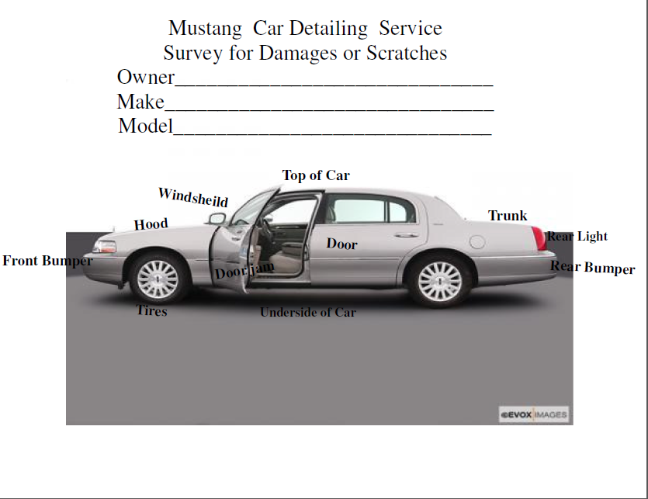
Step One: Before you wash car
Design a form to survey for damages or scratches already on the car. Have the customer view the form and sign off that they agree.

Slide 3
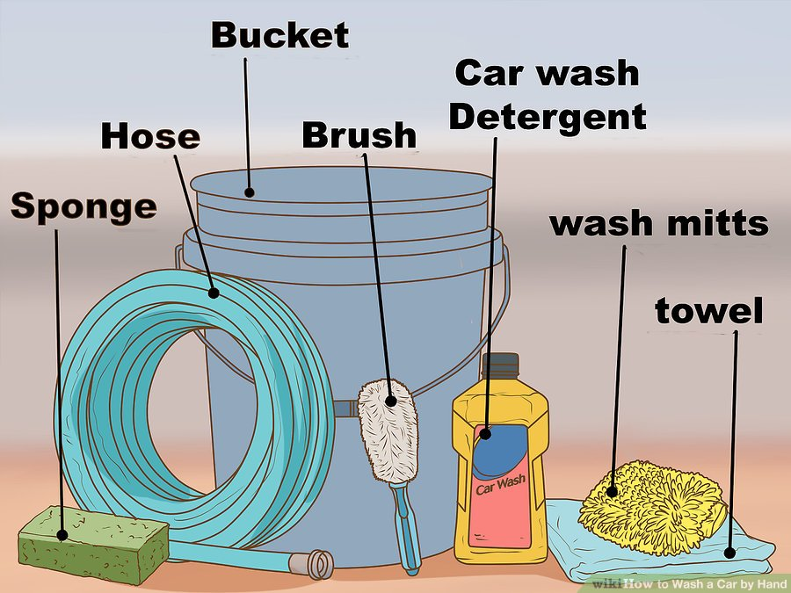
Supplies you will need
Sponges
Hose/hooked up to water supply
Buckets (two for washing, one for rinsing)
Brushes (two for washing and one for tires)
Car wash detergent
Wash mitts
Towels to dry

Slide 4
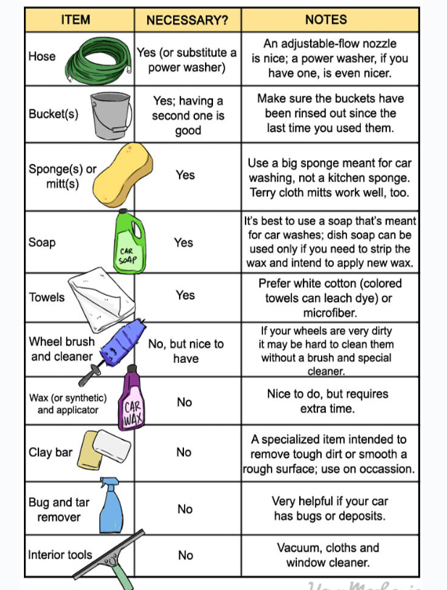

Slide 5
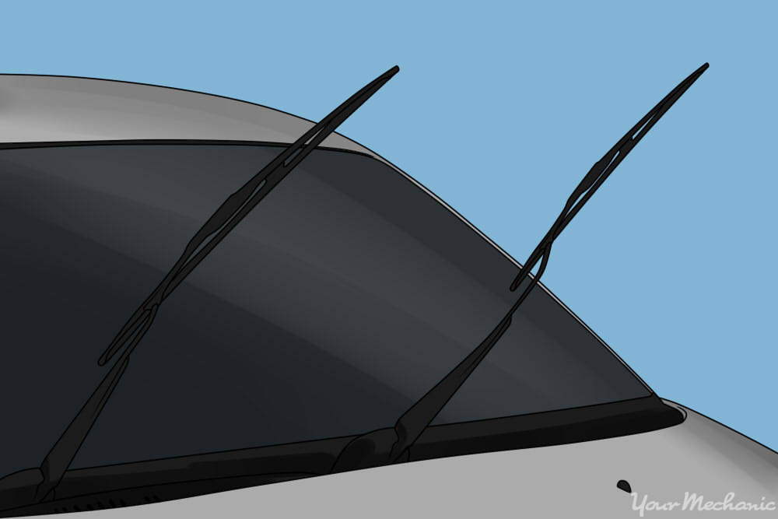
Step Two: Prepare Car for wash
Park the car out of direct sunlight.
Check that all windows are closed.
Pull the windshield wipers away from the windshield.

Slide 6
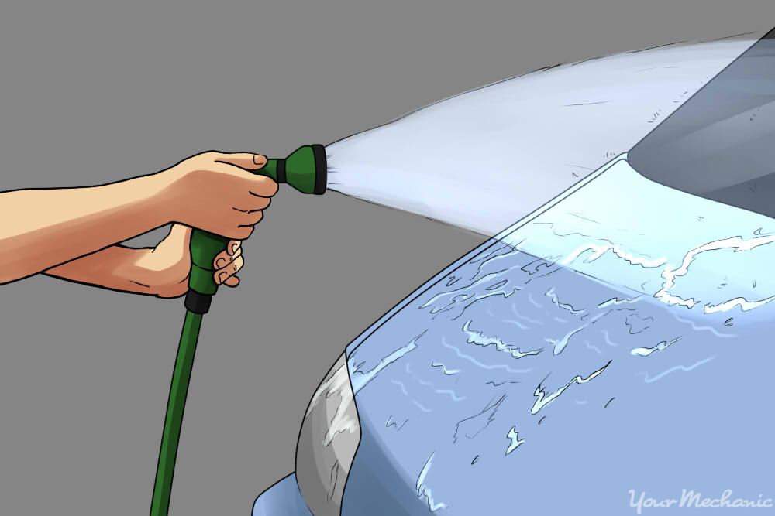
Step Three: Initial rinse
Fill two buckets about halfway with water and soap, the other halfway with plain water.
Do an initial rinse. To start, rinse the entire car with a full stream. Do everything, paying particular attention to the wheel wells and the underside of the car, as you want to rinse off heavy accumulations of dirt and road salt.
Attack bugs, sap, and other gunk

Slide 7
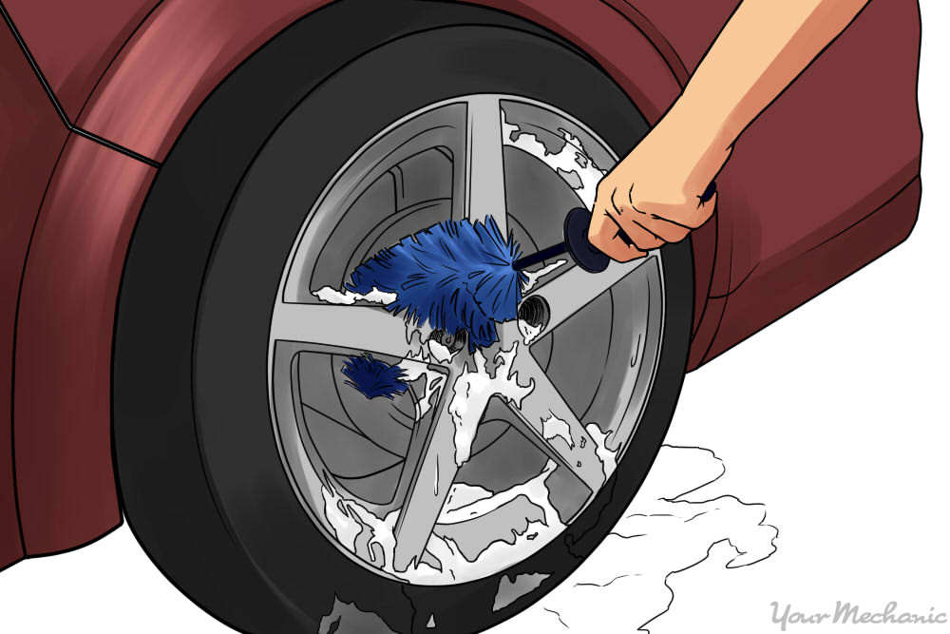
Step Four: Tires
Clean the wheels separately.
Wheels can get particularly dirty, not just from road dirt but also from “brake dust,” which can be particularly hard to remove. Try to attack each wheel with lots of soap and brush to get into corners and tight areas.

Slide 8
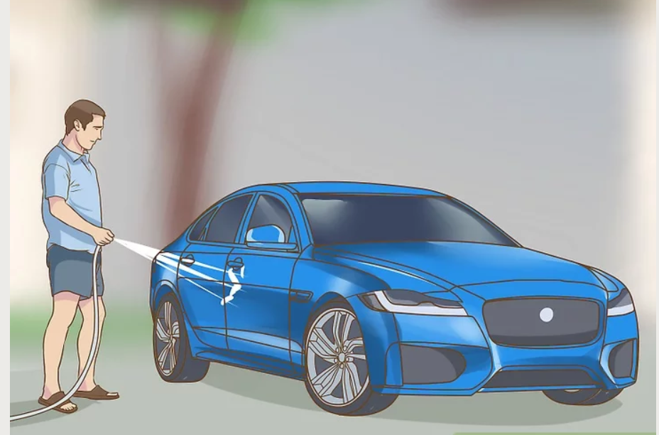
Step Five: Soap & Wash Car
Soap and rinse the car. Now it’s time for the overall wash. First wet down the whole car again if it’s dried (you’ll be trying to keep the entire car wet during this next step). Then pick a medium sized area such as a fender, and wash with a soapy (dripping wet is good) sponge. Use a back-and-forth motion rather than circles. Medium pressure is fine.
When the sponge gets dirty, rinse it out in the second bucket, then soap it up again in the first bucket.
After you’ve completed one area, rinse it. Use a hose, either without a nozzle or with a very wide pattern. Make very sure to rinse off all the soap. When you’re done rinsing, make sure the rest of the car is still wet and then move on to sponge off the next area.
When you’ve soaped and rinsed the entire car — painted panels, chrome, and glass — step back and make sure you didn’t miss any spots. Easy-to-forget parts include the roof, the radio antenna, and the side view mirrors.

Slide 9
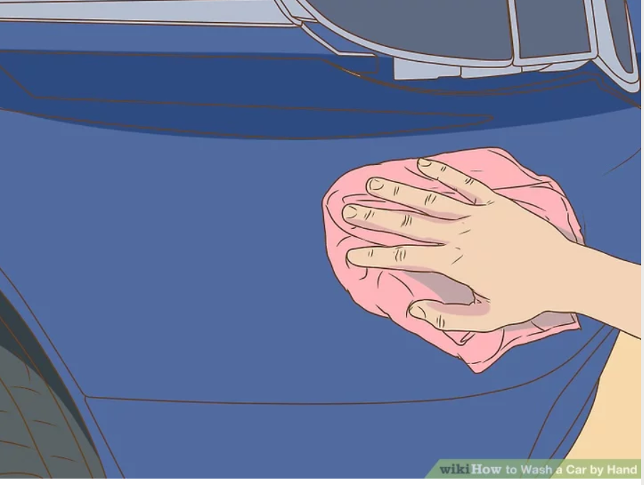
Step six: Drying the car
Dry the car.
It’s possible to let your car air dry, of course, but you’ll be left with water spots. Much better is to dry it yourself. Break out your towels and get to work drying the whole thing. You may have to work quickly, especially if it's a warm day, but remember that you can always wet part of it down again if you find that a panel has dried and has visible spots.

Slide 10
Step Seven: Clean up
Clean up.
Rinse out your buckets, brushes, and sponges. Ensure that the hose is shut off, and put it away.
Most towels and mitts can be machine washed, preferably in a separate load from clothes.

