Slide 1
Coffee Shop

Slide 2
Step One: Create a Google Doc or similar order form.

Slide 3
Step Two: Students are assigned to make specific coffees/drinks

Slide 4
Step three: Coffees are used based on organizational system

Slide 5
Step four: sugar and creamers are added according to orders

Slide 6
Step five: Once drink is prepared, it is transferred to delivery cart

Slide 7
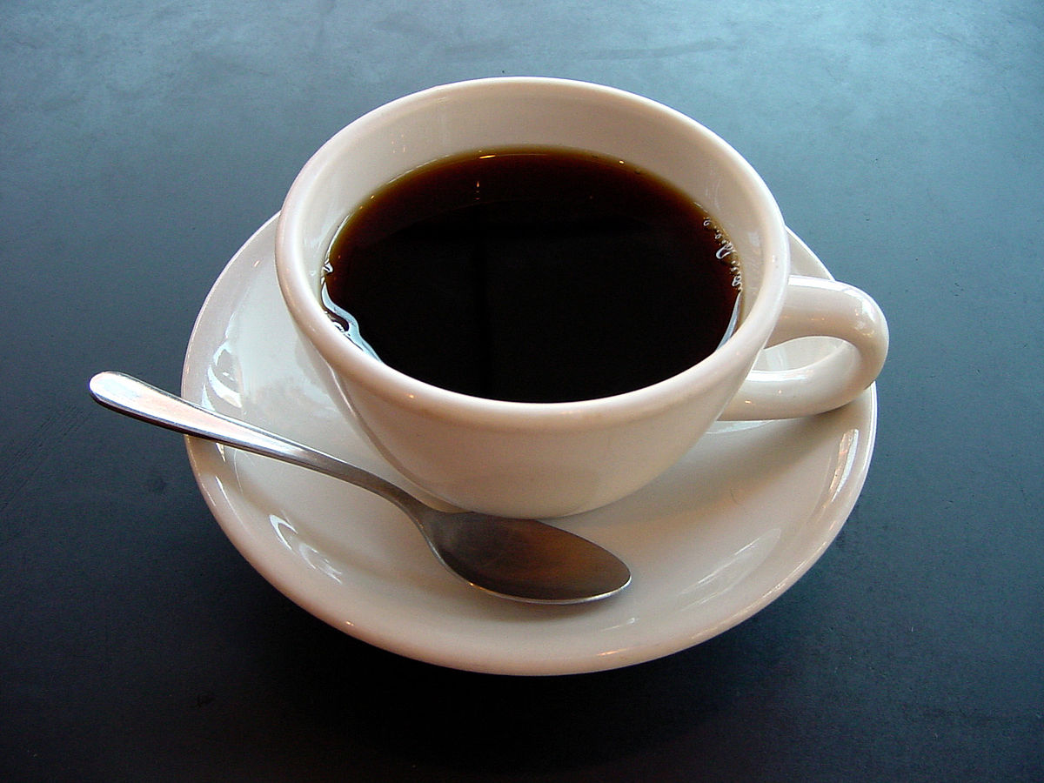
Step six: Have a system for delivery
Coffee can be delivered to classrooms
Pick Up location
Specific times in between classes

